Slide 1
Digital Assistant for Legal Awareness and Designing a KYR( Know-Your-Rights) framework in India
PIP2001 Capstone Project
Review-1
Batch Number:
ROLL NUMBER | STUDENT NAME
20211COM0071 | P SAITEJA
20211COM0093 | VISHNU PRIYA S
20211COM0074 | VAISHNAVI A L
20211COM0096 | SUJAN T
Under the Supervision of,
Dr. Pajany M
Assistant Professor - SCSE
School of Computer Science and Engineering
Presidency University
Name of the Program: Computer Engineering
Name of the HoD: Dr. Gopal Krishna Shyam
Name of the Program Project Coordinator: Dr. Sudha P
Name of the School Project Coordinators: Dr. Sampath A K Associate Professor (SG), Dr. Abdul Khadar A Associate Professor, Mr. MD ZIAUR RAHMAN

Slide 2
Introduction
Justice is meant to protect the innocent and punish the guilty, but when the system is misused, it becomes a tool of oppression rather than fairness. Fake cases, often filed with malicious intent, not only ruin lives but also burden the judiciary, delaying justice for genuine victims. From wrongful accusations to politically motivated trials, the dark side of justice reveals a disturbing reality where power and influence can distort truth. This case study aims to unmask false cases, expose their devastating consequences, and explore legal remedies to protect our rights.
"Injustice anywhere is a threat to justice everywhere."

Slide 3
Literature Review
Legal Literacy: Empowers individuals to understand rights (Sharma, 2018).
Barriers: Lack of access and complexity hinder awareness (Smith & Johnson, 2020).
Social Equity: Increases justice for marginalized groups (Rodriguez, 2019).
Technology: Digital platforms improve access to legal info (Singh & Patel, 2021).
School Education: Teaches legal rights early, promoting responsible citizenship (Hassan, 2017).

Slide 4
Existing Method Drawback
Existing Method | Description | Drawbacks
Government Websites (e.g., Nyaaya, e-Courts, National Legal Services Authority) | Online portals providing legal information, case status tracking, and complaint filing. | - Complex legal language, difficult for common citizens. - Lack of interactive support or real-time assistance. - Poor accessibility in rural areas due to internet issues.
Legal Aid Clinics | Free legal consultation centers run by NGOs and government agencies. | - Limited availability in remote areas. - Overburdened with cases, leading to long delays. - Requires physical presence, which can be inconvenient.
AI Chatbots for Legal Help (e.g., Lawy, Advocate.AI) | AI-powered virtual assistants that provide automated legal guidance. | - Cannot handle complex or case-specific legal queries. - Limited multilingual support. - Lacks emotional intelligence compared to human lawyers.
Printed Legal Handbooks & Pamphlets | Distribution of legal guides and KYR booklets in different languages. | - Quickly outdated due to frequent changes in laws and policies. - Limited interactivity; users cannot ask questions. - Requires literacy, excluding a large portion of the population.
YouTube & Social Media Awareness Campaigns | Videos and posts simplifying legal rights and procedures. | - Misinformation risk due to unverified sources. - Not all users engage with legal content online. - Difficult to verify the accuracy of legal explanations.
Legal Helplines (e.g., 15100, NGO Legal Aid Hotlines) | Phone-based support for legal queries. | - High call volumes lead to long wait times. - Limited hours of operation. - Language barriers in some regions.

Slide 5
Objectives
Enhance Legal Awareness – Provide simplified and accessible legal information to help citizens understand their rights and responsibilities.
Increase Accessibility – Support multiple regional languages, voice-based interactions, and offline services to reach rural and marginalized communities.
Enable Real-Time Assistance – Develop an AI-powered chatbot or virtual assistant for instant responses to legal queries.
Ensure Trust & Credibility – Collaborate with legal experts, government agencies, and NGOs to provide accurate and verified legal information.
Protect User Privacy & Security – Implement strong data privacy measures to safeguard users' sensitive legal inquiries.

Slide 6
Proposed Method
AI Chatbot – Provide multilingual, AI-driven legal assistance.
Voice & Text Support – Enable voice and text-based interactions for accessibility.
Offline & SMS Access – Offer legal help via USSD and SMS for rural users.
Legal Database Integration – Connect with government legal resources and helplines.
Data Privacy – Ensure user confidentiality with encryption and compliance.

Slide 7
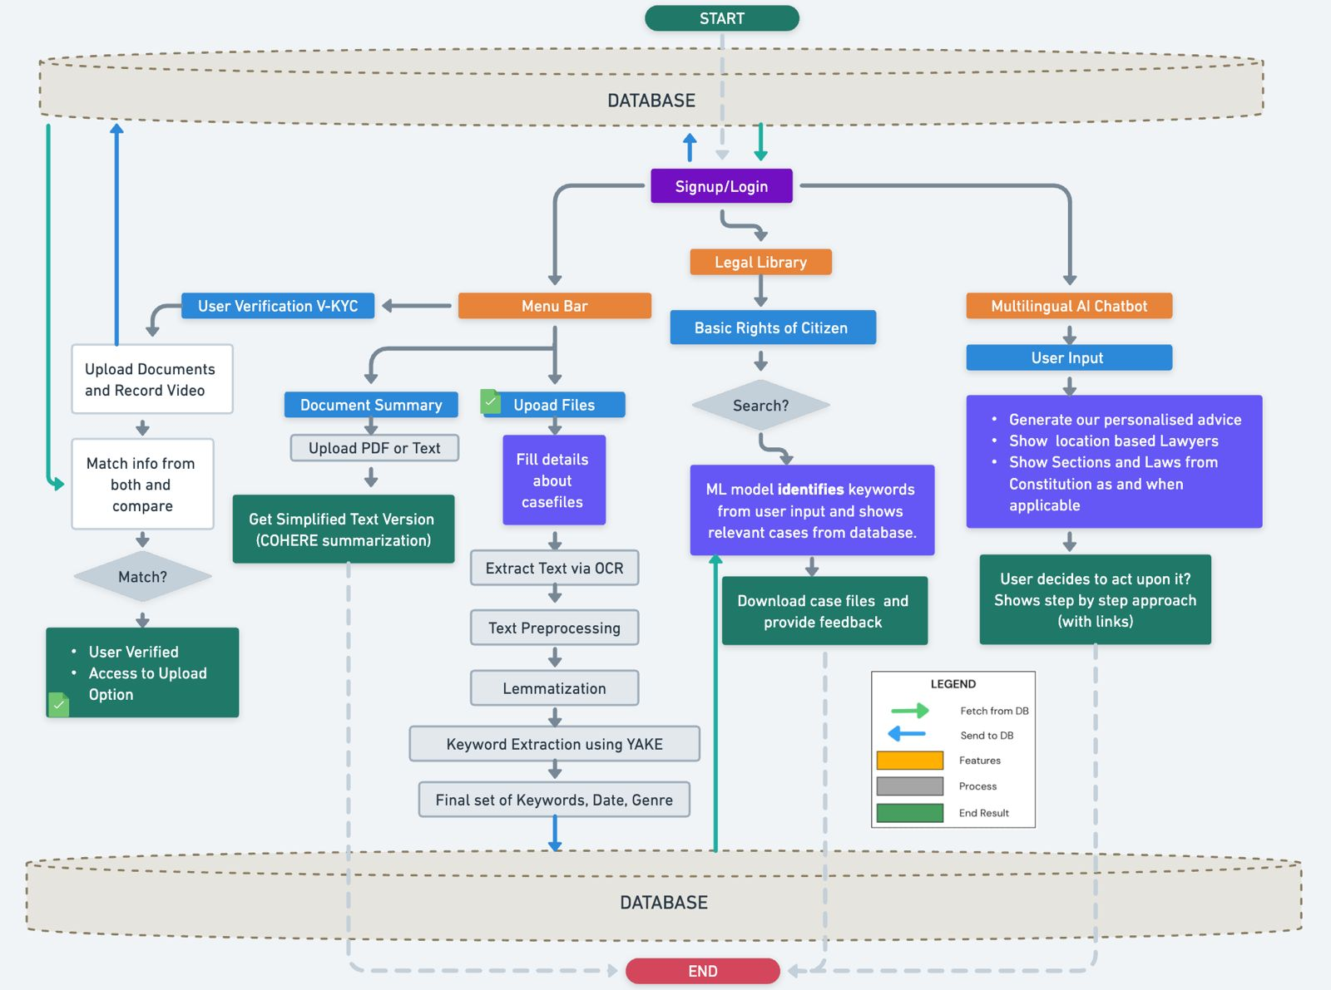
Architecture

Slide 8
Methodology
Data Collection – Gather legal information from verified sources.
AI Development – Train an NLP-based chatbot for legal queries.
User Interface – Enable voice and text-based interactions.
Integration – Connect with legal helplines and government portals.
Testing & Feedback – Improve accuracy through user testing.
Multilingual Support – Implement regional language support for wider accessibility.
Security & Privacy Measures – Ensure data encryption and compliance with legal privacy regulations.

Slide 9
Software Components
User Interface (UI): The part of the software that interacts with the user, including graphical elements like buttons, forms, and navigation.
Database: Stores and manages data, allowing software to retrieve, manipulate, and store information.
Middleware: Software that connects different applications or services, enabling communication and data exchange between systems.
Application Logic: Contains the core functionality and business rules of the software, processing inputs and generating outputs.
Security Components: Protects the software from unauthorized access, including authentication, encryption, and data protection mechanisms.

Slide 10
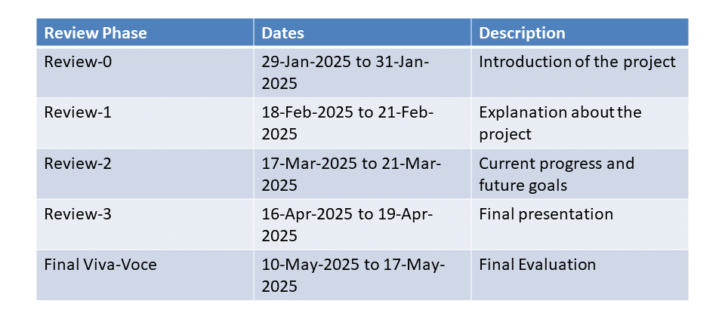
Timeline of the Project (Gantt Chart)

Slide 11
Expected Outcomes
Improved Legal Awareness
Users will gain easy access to understandable legal information, empowering them with knowledge about their rights and responsibilities.
Wider Accessibility
The platform will be accessible to diverse groups, including rural and illiterate populations, through multilingual, voice, and text-based interactions.
Increased Legal Empowerment
Users will feel more confident in handling legal issues by accessing immediate and accurate legal guidance.
Scalable Reach
The system will cater to a large number of users, providing consistent service across different platforms (mobile, web, SMS), ensuring it grows with the user base.
Enhanced Trust in Legal Processes
With secure data handling and reliable legal resources, the platform will foster trust in the legal system, encouraging more people to seek legal assistance when needed.

Slide 12
Conclusion
The Digital Assistant for Legal Awareness and the KYR framework has the potential to transform access to legal resources, particularly for marginalized and rural communities. By leveraging AI, NLP, and multilingual capabilities, the platform will provide instant, reliable legal information, ensuring that people are empowered to understand and assert their rights. Offline access via SMS/USSD ensures no one is left behind.

Slide 13
References
A. M. Khandai and P. R. Dahiya, "Legal Chatbots: A New Era in Legal Services," International Journal of Innovative Research in Computer Science & Technology, vol. 7, no. 1, pp. 10-17, 2020. Link
D. L. Porter, "AI-Powered Legal Chatbots: A Step Toward Reducing Access Barriers to Justice," Journal of Technology in Human Services, vol. 36, no. 2, pp. 115-133, 2018. Link
D. K. Bansal, "Legal Chatbots and Their Impact on Legal Assistance in India," Indian Journal of Law and Technology, vol. 12, no. 1, pp. 45-58, 2021. Link
N. L. Buchwald and J. M. Best, "AI and Legal Services: The Role of Chatbots in the Future of Law," Journal of Legal Technology, vol. 25, no. 4, pp. 28-36, 2019. Link
R. Jain and A. Verma, "Development of a Chatbot for Legal Assistance: A Case Study," International Journal of Artificial Intelligence and Law, vol. 24, no. 3, pp. 215-226, 2019. Link

Slide 14
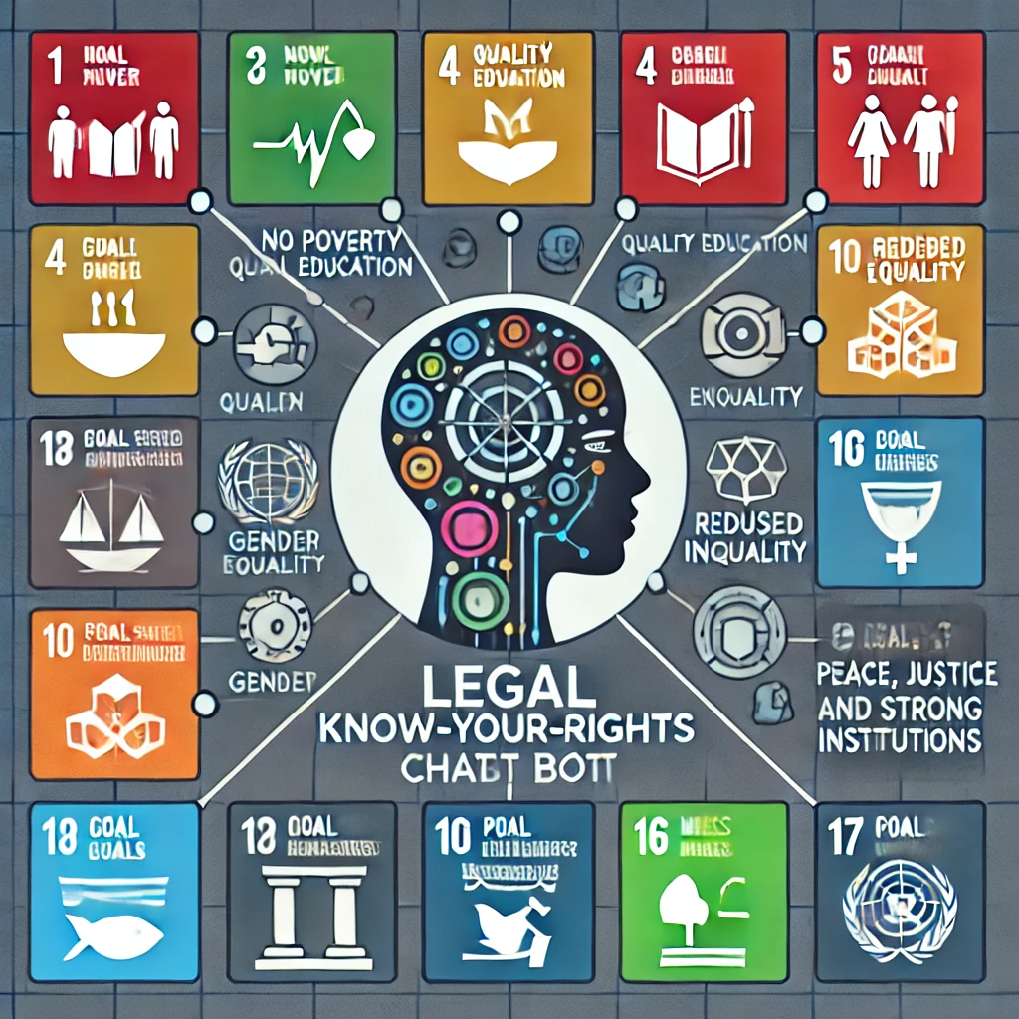
Project work mapping with SDG
SDG | Relevant Goal | Connection to the Project
Goal 1 | No Poverty | Legal empowerment can help marginalized populations access justice and resources, reducing vulnerability to exploitation and poverty.
Goal 4 | Quality Education | The chatbot can serve as an educational tool, offering legal literacy to all, particularly underserved populations.
Goal 5 | Gender Equality | The project can provide equal access to legal knowledge, empowering women and ensuring they understand their rights.
Goal 10 | Reduced Inequality | By making legal information accessible to all, the project helps reduce disparities in access to justice, particularly for disadvantaged groups.
Goal 16 | Peace, Justice, and Strong Institutions | The chatbot enhances access to justice and the rule of law, empowering individuals with knowledge of their legal rights and remedies.
Goal 17 | Partnerships for the Goals | Collaboration with legal experts, NGOs, and government bodies ensures the system is effective and reaches a wide audience.

Slide 15


